Slide 1
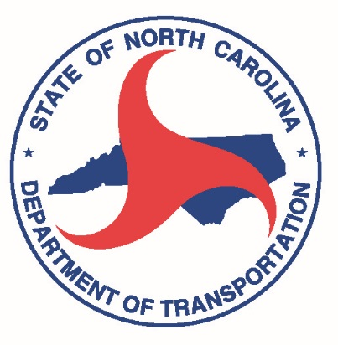
"Creative Engagement Strategies : Mixing it up"
Part of the NCDOT-PTD and NCPTA
Lunch and Learn Series

Slide 2
Welcome
The North Carolina Public Transportation Association (NCPTA) is a private, nonprofit organization that was incorporated in January 1983. With a vision of “Excellence in Public Transportation,” the Association’s mission is “Supporting our members and the public they serve through advocacy, education, and collaboration.”
https://www.nctransit.org/
Training Committee
Mark E. Kirstner - markk@partnc.org
Rodney Harrison - rlhar@salisburync.gov
2019 NCPTA Annual Conference

Slide 3
Housekeeping
Please enter the number of people watching from your location in the Chat Box so we know how many people viewed the webinar.
There will be a Q & A session at the end of the webinar. Enter your questions into the Chat Box.
The webinar is being recorded and link will be emailed out to everyone, hopefully within a few days.

Slide 4
Today’s Lineup
Shout out to Debbie Collins and Blair Chambers
Creative Engagement Strategies : Mixing it Up
Jason Lawrence
Senior Transportation Planner with Charlotte Area Transit
Molly Carter
Transportation Planner with Charlotte Area Transit

Slide 5
Transportation planners must seek creative engagement strategies that demonstrate right of way use for all transportation modes as well as interactive bus service planning. This session will detail the use of interactive online based tools like Streetmix and Remix to illustrate trade offs.

Slide 6
Q & A
Please use the Chat Box.
The webinar is being recorded and link will be emailed out to everyone, hopefully within a few days.
Coming Up
Next Lunch and Learn
March 8th –/ TBD Any ideas?
NCAMPO 2019 Annual Conference
April 24-26, 2019 - Charlotte Convention Center
NCPTA 2019 Annual Conference
April 27 – 28 Rodeo
April 29 – May 1 Conference
Registration Opens Monday January 14

Slide 7
"Creative Engagement Strategies : Mixing it up"
Part of the NCDOT-PTD and NCPTA
Lunch and Learn Series

